Slide 1

Project Black Sky: Watching the Watchers
Suspicious skies, revealed.

Slide 2
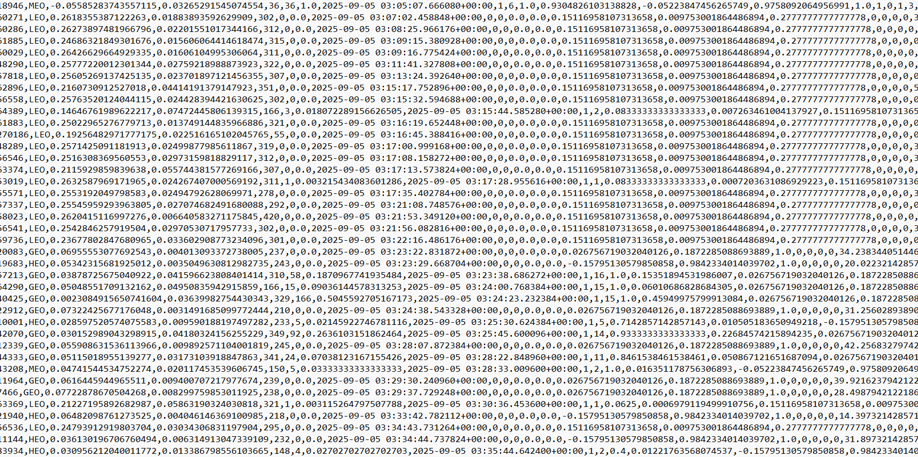
anomalous_rows.csv
scores.csv
dailies.csv

Slide 3
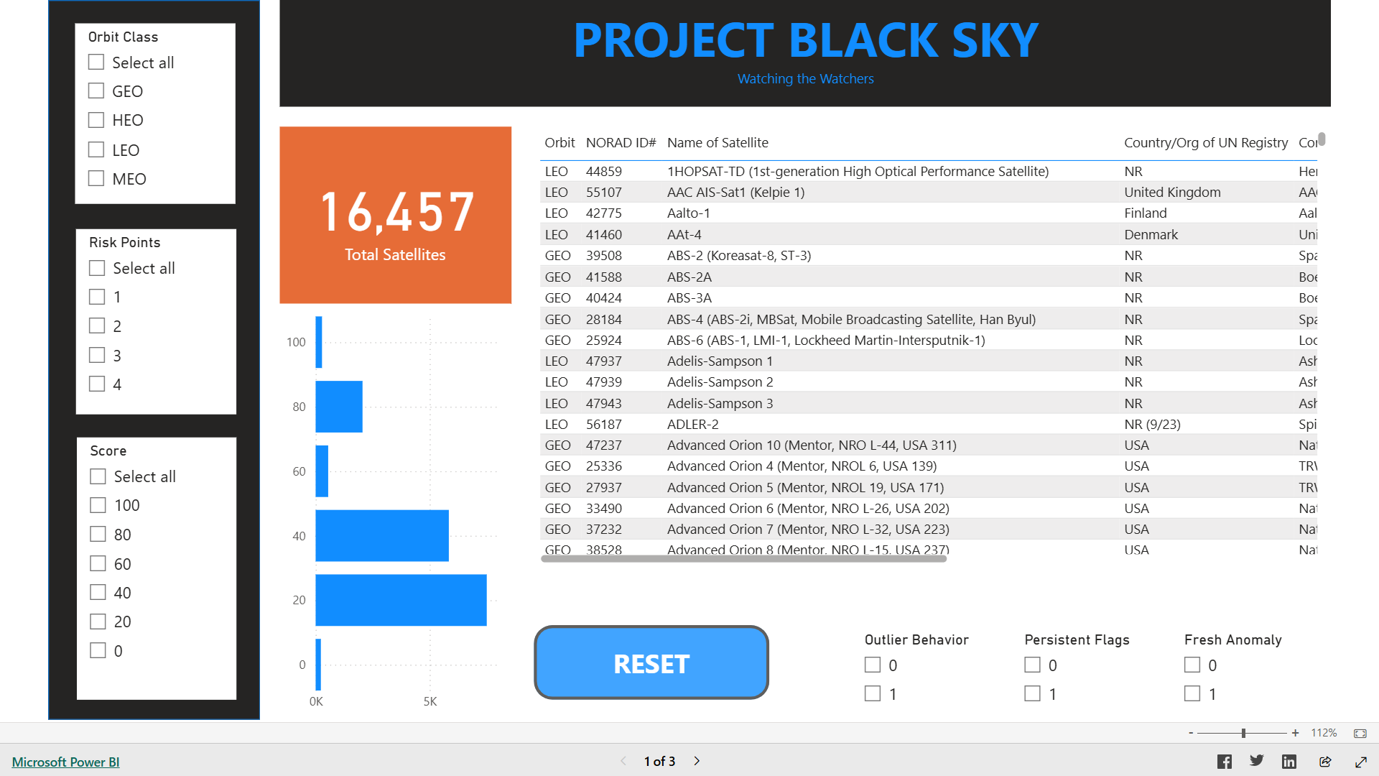

Slide 4
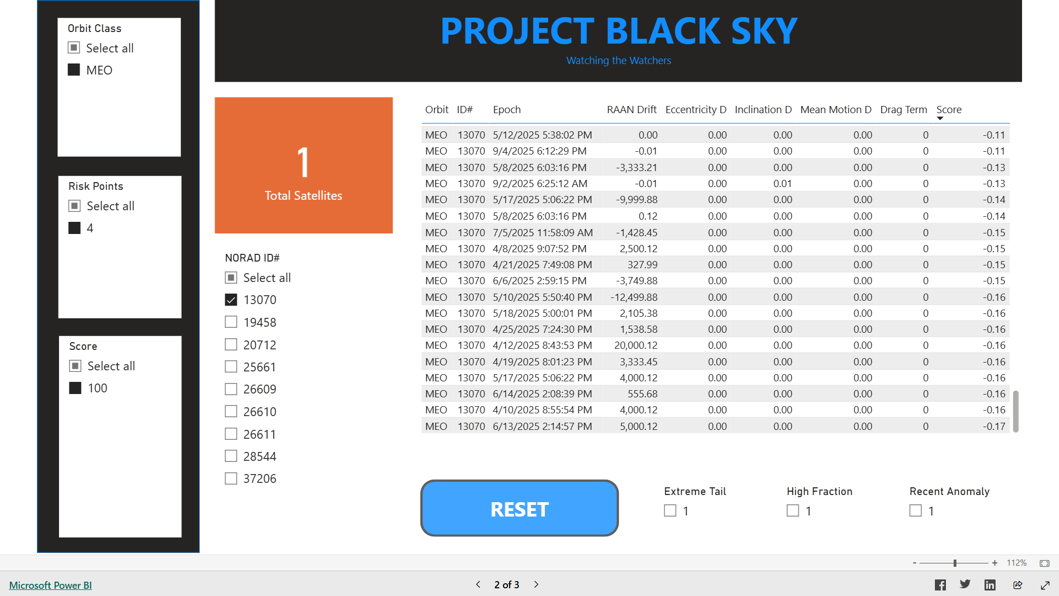

Slide 5
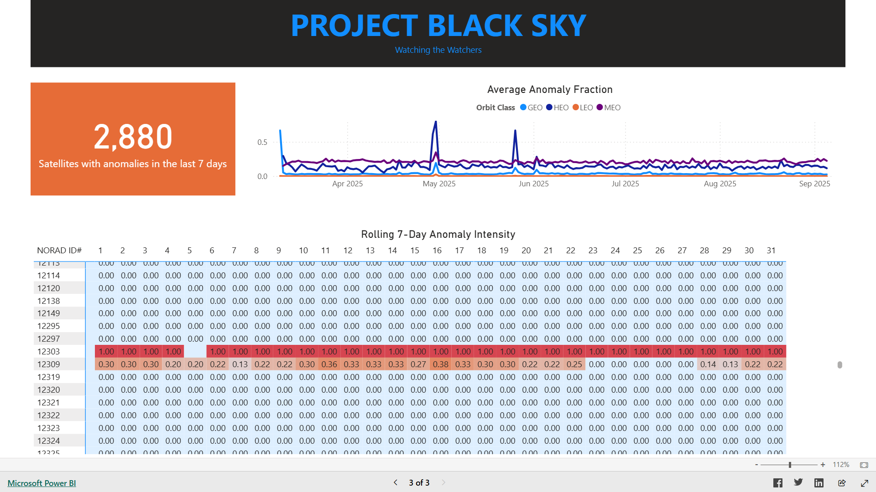

Slide 6
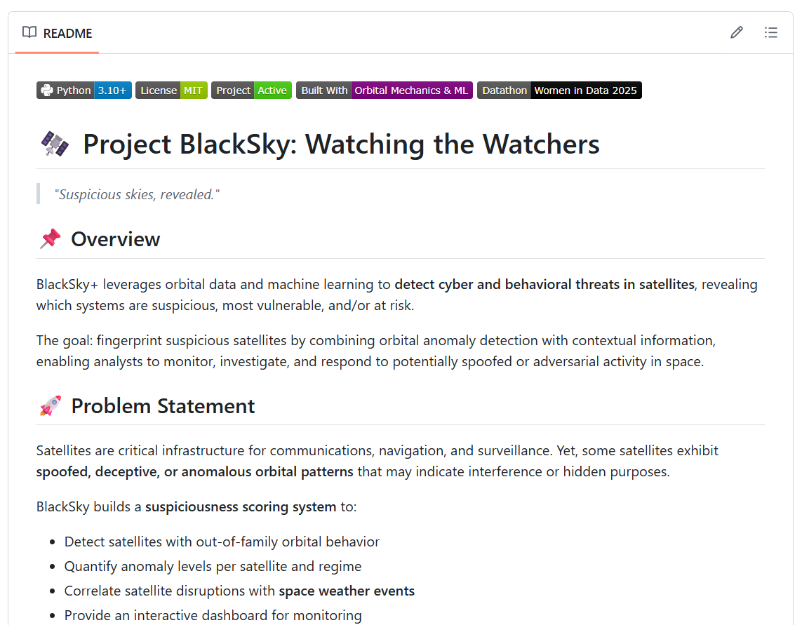

Slide 7

A datathon project by:
Elaine’s Datanauts
Team Members:
Ednalyn C. De Dios
Marwah Obaid
Peace Edwins
Saarah Hossain
Tuhina Chaudhari

